Slide 1
Sleep DEG summary
ZZY
2023. 3. 27

Slide 2
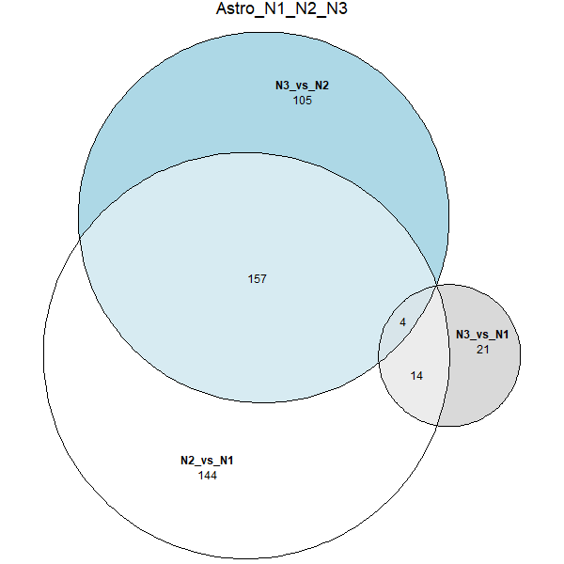
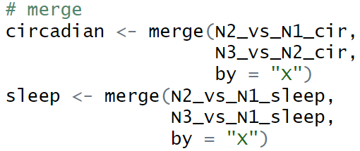
 | sleep | circadian
NS(N1) | Sleep | ZT6
NW(N2) | Wake | ZT18
SD1D(N3) | wake | ZT6
Circadian genes
sleep genes

Slide 3
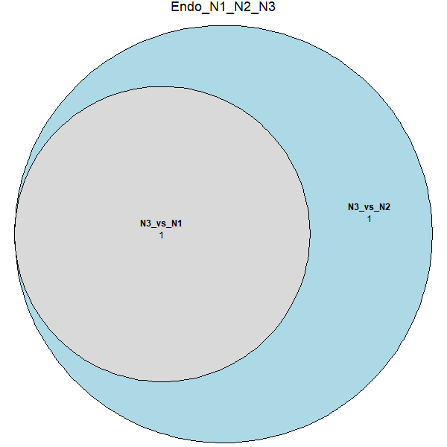
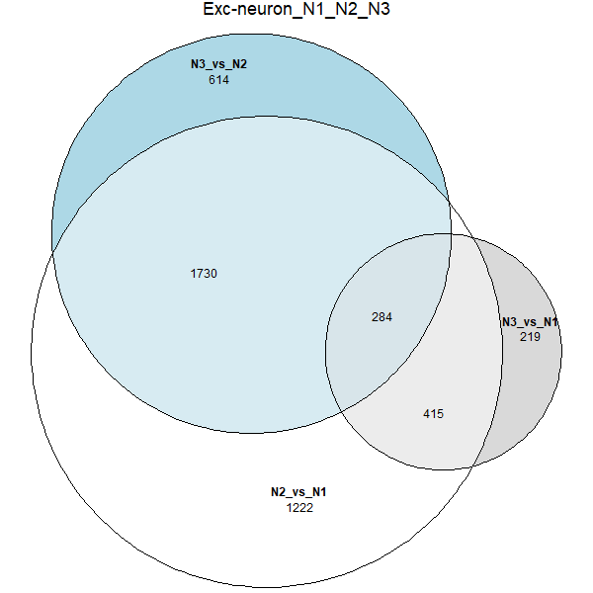
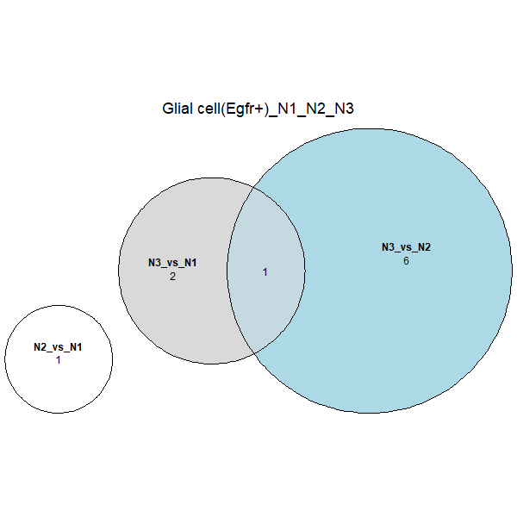
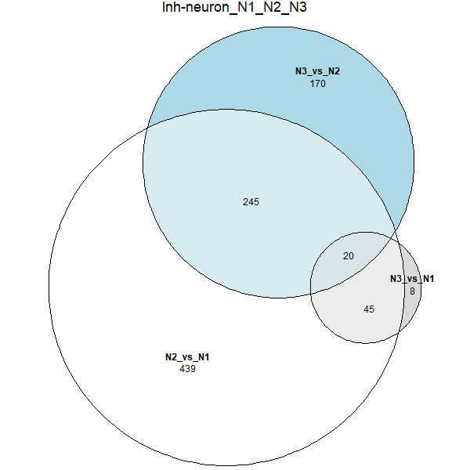
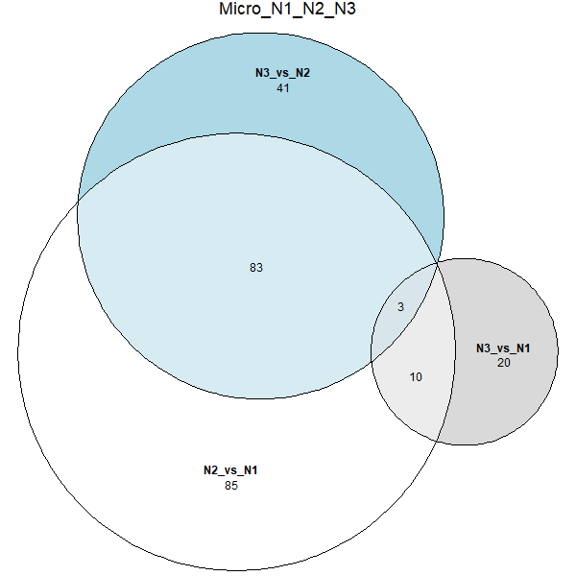
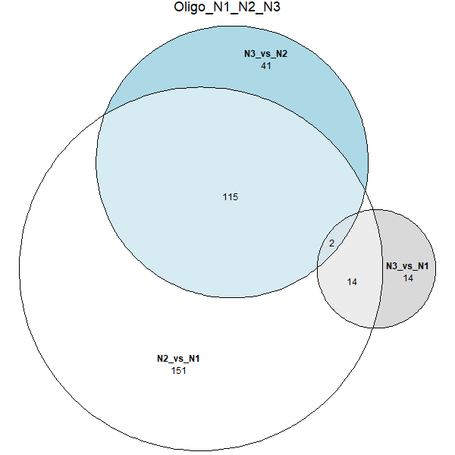
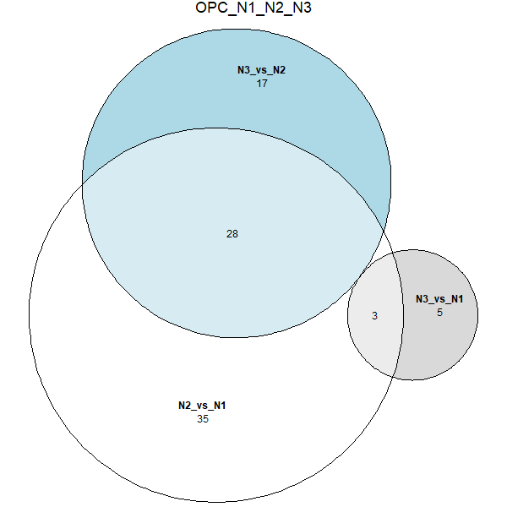
Sleep patterns in each cell type

Slide 4
Sleep DEG number summary
 | Astro | Endo | Exc neuron | Glial cell(Egfr+) | Inh neuron | Micro | Oligo | OPC
Total No. | 18 | 0 | 699 | 0 | 65 | 13 | 16 | 3
Exclusive No. | 4 | / | 634 | / | 10 | 1 | 4 | 0
Total sleep DEG number(remove repeat): 721
Notes:
Exclusive: 只在该细胞类型中的DEG

Slide 5
Sleep all DEG hits in circadian databases
Total sleep DEG number(remove repeat): 721
Total DEG hits: 76
Top 20 hits | Total Hits in databases
Arc | 3
Fos | 3
D130043K22Rik | 2
Hunk | 2
Nr4a3 | 2
Pla2g4e | 2
Rad51ap2 | 2
Rasl10a | 2
Slc6a6 | 2
Spred1 | 2
Wnt9a | 2
Zdhhc8 | 2
Zfp46 | 2
Nrg3 | 1
Actg1 | 1
Adam23 | 1
Adgrb3 | 1
Ankrd28 | 1
Ankrd6 | 1
Apbb2 | 1
Notes:
Altered hippocampal transcriptome dynamics following sleep deprivation | Molecular Brain | Full Text (biomedcentral.com)
Translational changes induced by acute sleep deprivation uncovered by TRAP-Seq | Molecular Brain | Full Text (biomedcentral.com)
A systems genetics resource and analysis of sleep regulation in the mouse | PLOS Biology
https://doi.org/10.1371/journal.pbio.2005750.s009
https://doi.org/10.1371/journal.pbio.2005750.s010

Slide 6
Sleep cell type specific DEG hits in sleep deprivation RNA seq databases
 | Astro | Endo | Exc neuron | Glial cell(Egfr+) | Inh neuron | Micro | Oligo | OPC
Total No. | 18 | 0 | 699 | 0 | 65 | 13 | 16 | 3
Hits in Total No. | 1 | / | 74 | / | 2 | 1 | 4 | 0
Exclusive No. | 4 | / | 634 | / | 10 | 1 | 4 | 0
Hits in Exclusive No. | 0 | / | 71 | / | 0 | 0 | 2 | /

